Slide 1
Customer Engagement Analysis with SQL & Tableau
Ahmed Hindy

Slide 2
Agenda
Project Overview
Data Understanding
Data Preparation (SQL)
Exploratory Data Analysis (SQL)
Visualization in Tableau
Insights and recommendations
Conclusion

Slide 3
Project overview
Overview:
Customer Engagement Analysis using SQL & Tableau
Focus: Student activity on the 365 data science platform
Building a 3-page interactive dashboard
Goal: Identify engagement patterns & areas of improvement
Objectives:
Identify most-watched & best-rated courses
Track student registrations & onboarding rate
Compare engagement: free vs. paying students
Analyze seasonal trends in content consumption
Compare registrations & engagement across countries

Slide 4
Data understanding
5 relational tables (courses, students, purchases, ratings, learning activity)
46 courses offered
35,230 students registered
3,041 purchases recorded
64,458 student learning records (tracking minutes watched over 10 months)

Slide 5
Data preparation
(SQL)

Slide 6
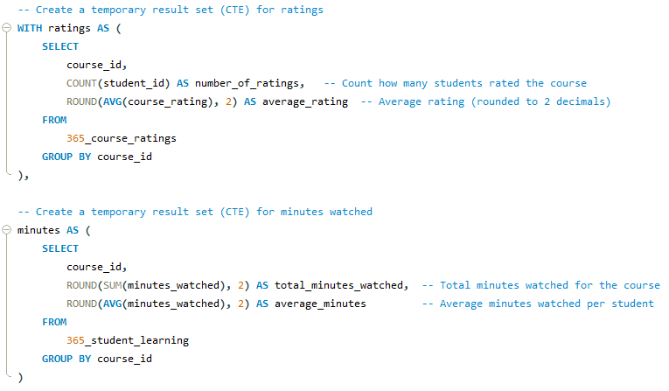
CTEs
Created CTEs to calculate:
Average & total course ratings
Total & average minutes watched per course

Slide 7
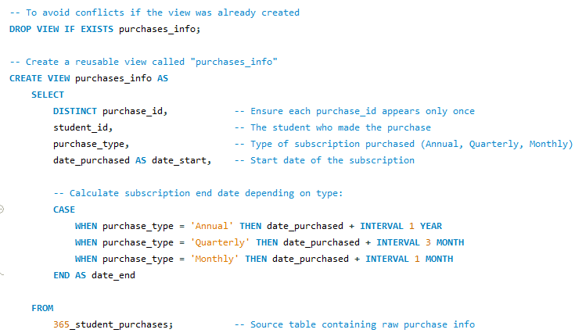
Views
Built views for reusability:
purchases_info: purchase type, start date, subscription end date

Slide 8
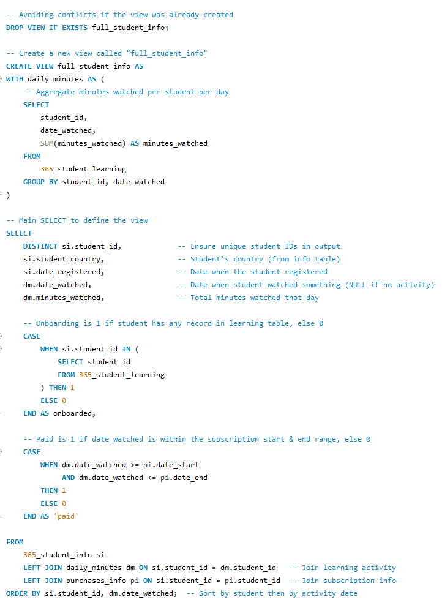
Views
Built views for reusability:
full_student_info: student details + activity + purchase status

Slide 9
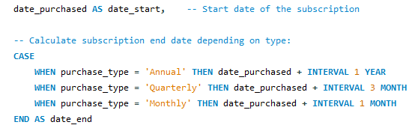
Calculated Derived Fields
Average Rating FROM The number of ratings
Average Minutes FROM Total minutes Watched
Subscription period (start date, end date) FROM Purchase Type(monthly, quarterly, annually) & Purchase Date

Slide 10
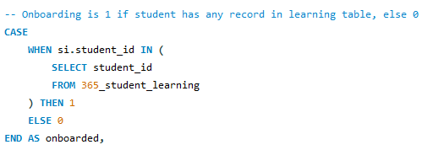
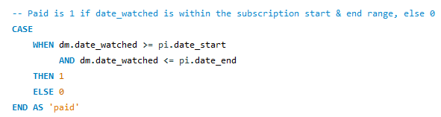
Created Engagement Indicators
Onboarded → student has started using the platform
Paid → student activity during an active subscription

Slide 11
Exploratory data analysis (SQL)

Slide 12
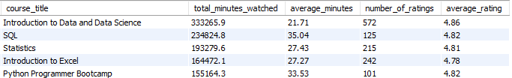
Top courses
As expected, introductory courses have much more visibility than other advanced courses

Slide 13
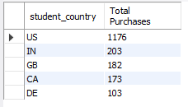
Top paying countries
USA has the most subscribers as ‘365 data science’ is an American platform
Followed by India (also English-speaking country) and a huge software market
Then comes Canada, England and Nigeria which are also English-speaking countries

Slide 14
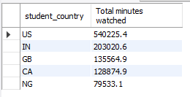
Top watching countries
The gap between USA and India’s watched minutes is smaller than the paying customer’s gap which can signal an expansion potential in India

Slide 15
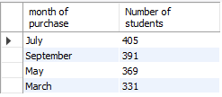
High performing months
A recurring patter is that odd numbered months (7, 9, 5, 3) have higher purchase rates
365 data science platform runs marketing campaigns every 2 months starting January (the increase of purchases is signaling a successful marketing strategy)

Slide 16
Visualization in Tableau

Slide 17
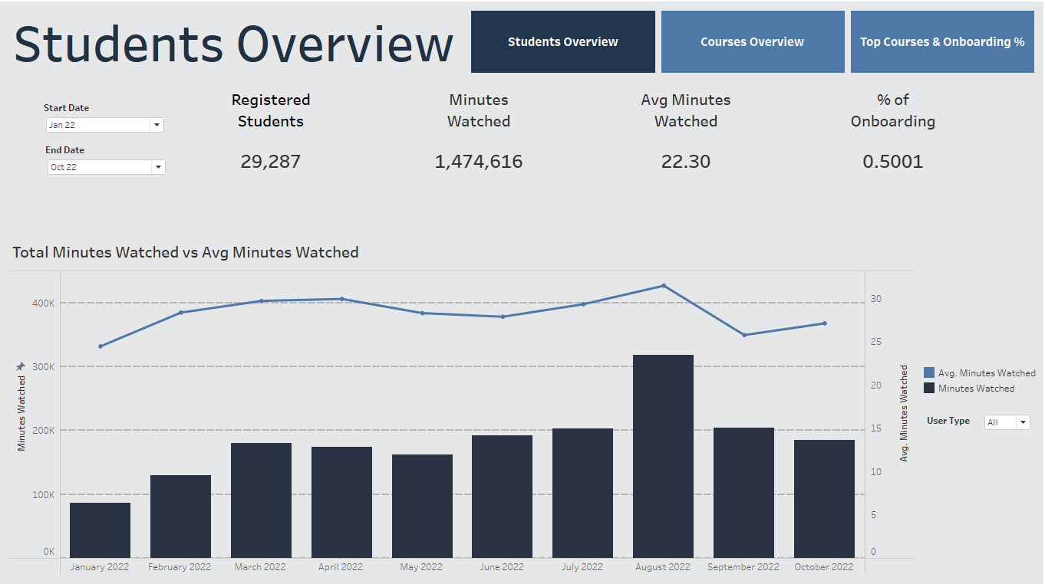

Slide 18
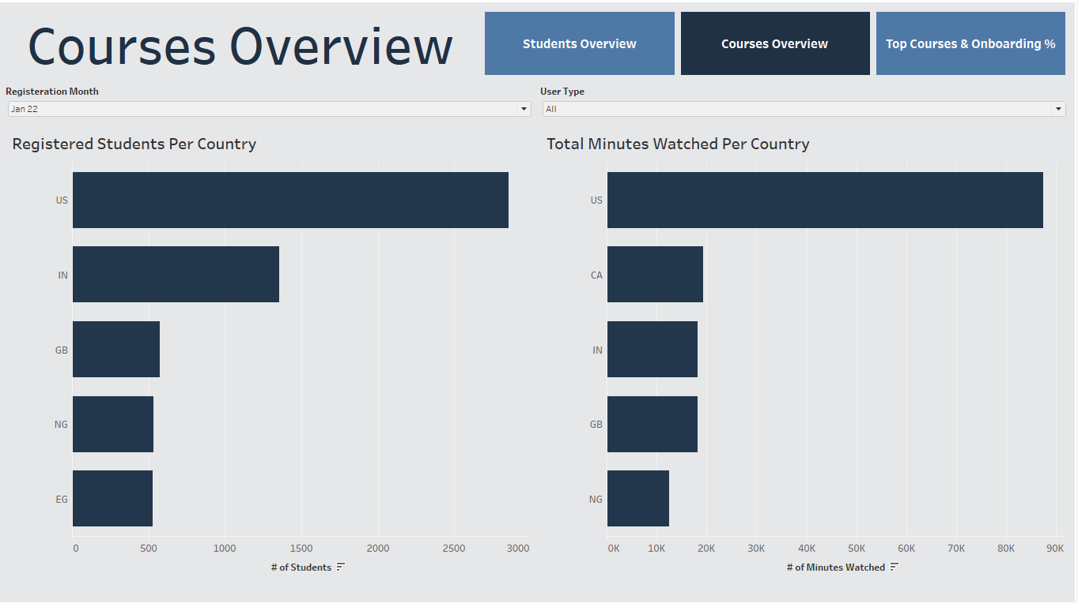

Slide 19
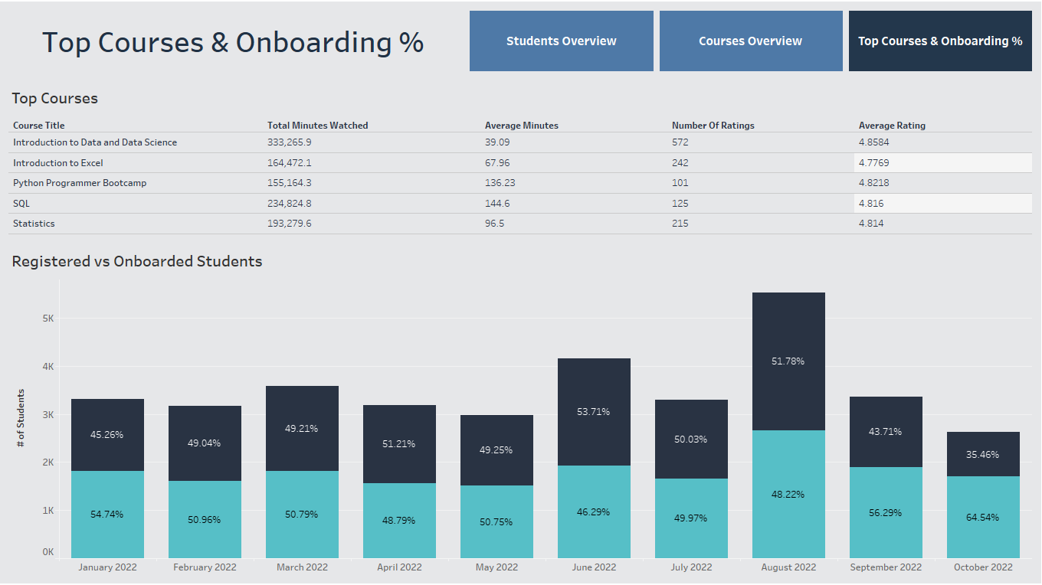

Slide 20
Insights & recommendations

Slide 21
Language & Market Expansion
Insight:
All top purchasing countries are English-speaking, aligning with the fact that all courses are currently in English.
Recommendation:
Consider translating courses (starting with subtitles, then dubbing/localization) to tap into large non-English-speaking markets (e.g., Latin America, East Asia, Middle East). Start with the markets showing high traffic but low purchases to maximize ROI.

Slide 22
Price Sensitivity in Emerging Markets
Insight:
India and Nigeria have high watch minutes but relatively fewer paying customers, likely linked to affordability constraints.
Recommendation:
Explore differentiated pricing strategies:
Regional pricing tiers or discounts.
Explore ad-supported models or sponsorships in regions where paid conversions are weaker.

Slide 23
Marketing Effectiveness
Insight:
Odd-numbered months (Jan, Mar, May…) outperform others, aligning with current marketing campaigns run in those periods.
Recommendation:
Increase investment in marketing campaigns during Even-numbered months as well.

Slide 24
Course Preferences
Insight:
Top-performing courses are introductory-level.
Recommendation:
Develop more introductory courses in popular subjects.
Create clear progression paths (Intro → Intermediate → Advanced) to increase lifetime value per learner.
Bundle courses (Intro + Advanced at a discounted rate) to encourage upselling.

Slide 25
Conclusion
Summary: The analysis shows that current growth is concentrated in English-speaking markets, with strong marketing-driven seasonality and a preference for introductory courses.
Key Recommendation: To unlock further growth, we should (1) expand into non-English markets through translation, (2) adapt pricing in emerging economies, and (3) deepen learner engagement with structured course progressions.
Next Steps: Test translation pilots, design regional pricing models, and plan year-round marketing to balance performance across months.

Slide 26
THANK YOU
Ahmed Hindy
Phone: +201145603297
E-mail: ahmed@ahmedhindy.com
Website: ahmedhindy.com

